Slide 1
IST 718: CREDIT CARD DEFAULT PREDICTION
Group 2 - Kevin Harmer and Chaithra K C

Slide 2
Project Overview
Credit Cards Companies brought in $176 Billion in 2020 (Caporal, 2021)
28% of all payment transactions use a credit card (Pakora, 2022)
Delinquent Credit Card Accounts have increased by 0.5% in the past 6 months (Shultz, 2022)
Objective: Predict when customer will default on their credit card payments and determine the strongest indicators of delinquency

Slide 3
Data Overview
30,000 credit card users and 24 columns
Dataset includes demographic information, credit limit, payment history, and bill statements
Payment history is from April 2005 to September 2005
Amount is in NTD currency (New Taiwan Dollars)
Target Variable - Default (or) Non-Default in the October 2005

Slide 4
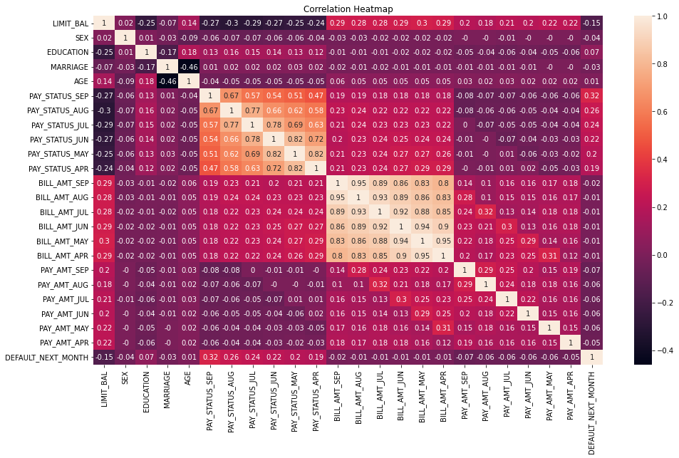
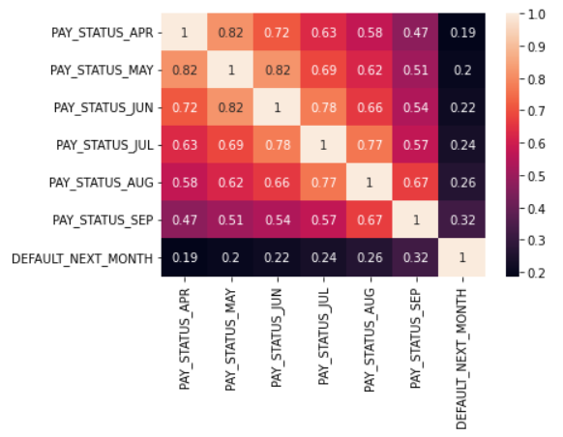
Correlation Clustering

Slide 5
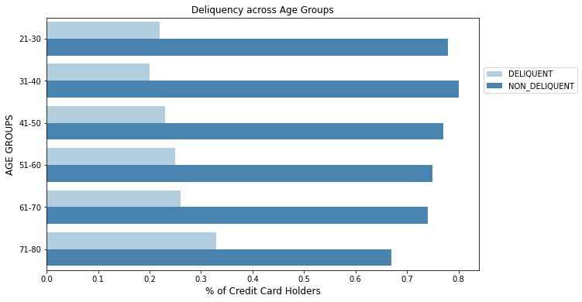
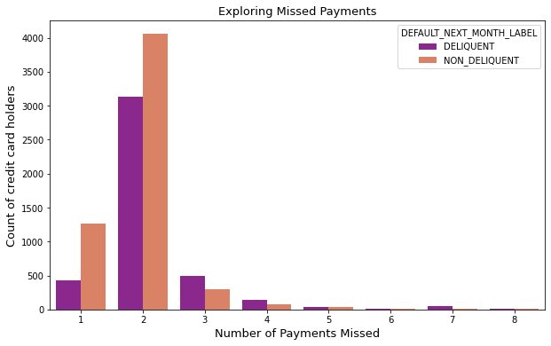
Delinquency Relationships

Slide 6
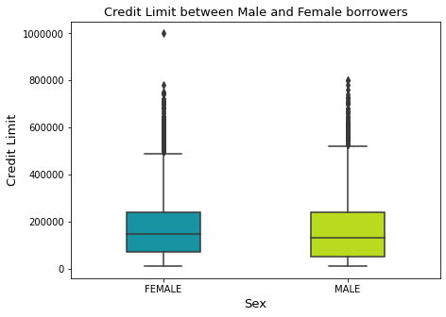
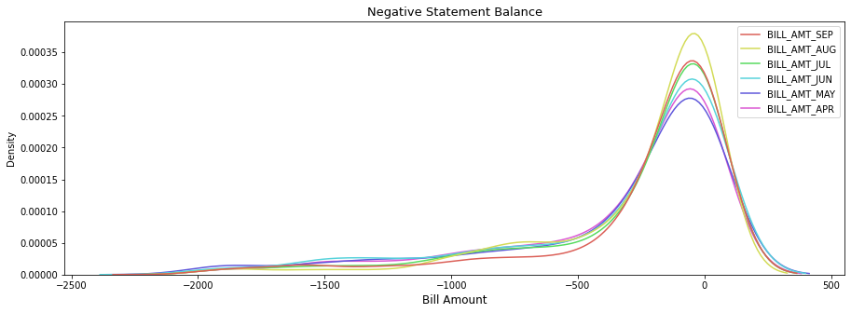
Other Data Exploration

Slide 7
Model Methodology
Data Wrangling
Feature Engineering
Data Balancing, then 80/20 Training/Testing Split
Model Development
Logistic Regression, Random Forest, Deep Learning
Parameter Tuning
Parameter Grid Search based on accuracy
Layer and Epoch Experimentation for Deep Learning Model
Model Comparison through Error Analysis

Slide 8
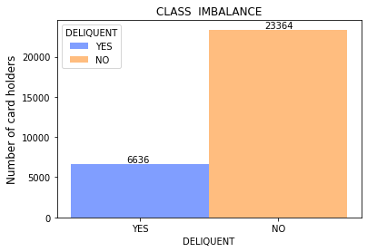
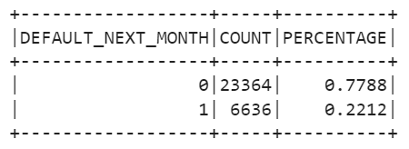

Data Preparation
Class imbalance has been handled using "Random Under-Sampling" technique
Transformations applied to Categorical Variables:
Education is an ordinal categorical data. It is best practice to maintain the order. Therefore, encoding the categories according to increasing level of education.
Marital Status is an unordered, plain categorical variable. This column can be one hot encoded.
Gender: There are only two categories in this column. We can simply encode 0/1
Random Train-Test split configuration: Train 80%, and Test 20%

Slide 9
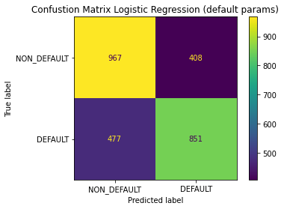
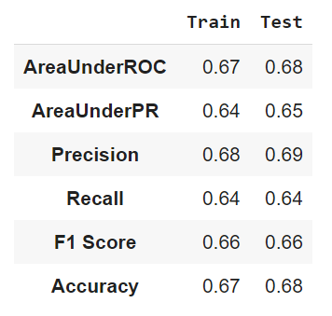
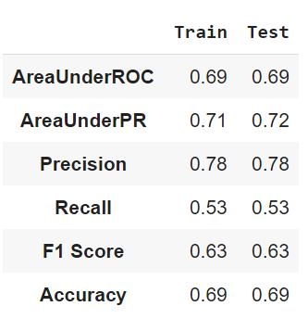
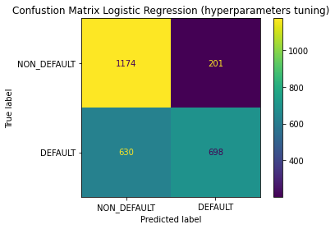
Logistic Regression
Logistic Regression (with default params)
23 features are used for training
Features are standardized for faster training, and comparing coefficients.
Logistic Regression (with CV and Regularization)
Grid search for elastic net regularization (alpha and lambda params) with 3 fold CV
No significant increase in model performance
It did help in feature selection
23 features are reduced to 6 features

Slide 10
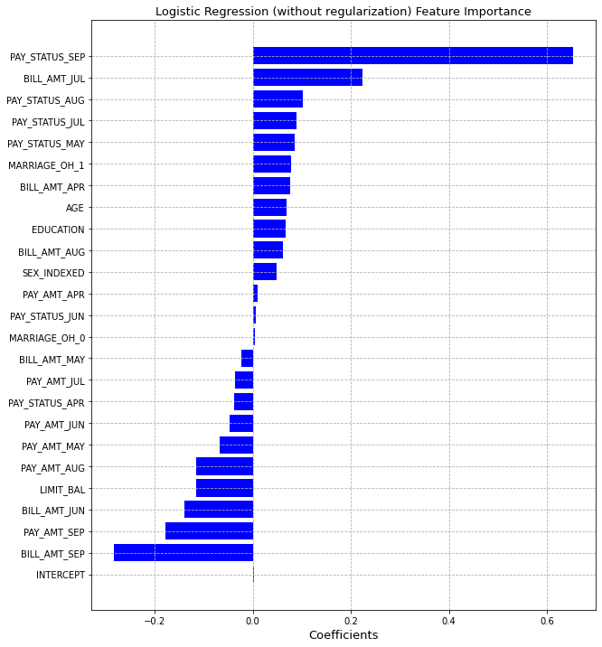
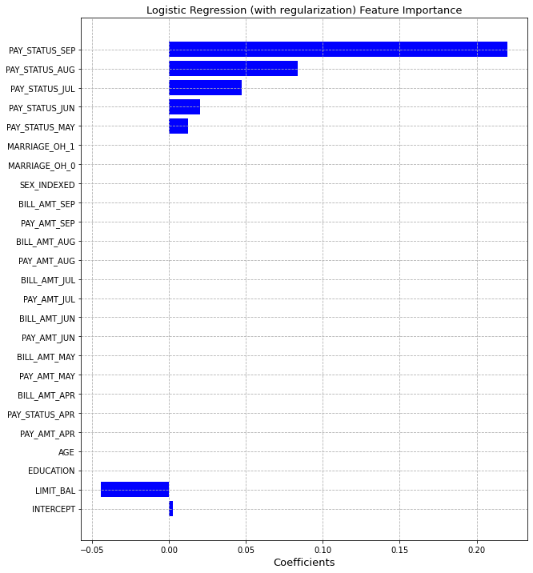
Logistic Regression: Feature Importance & Feature Selection

Slide 11
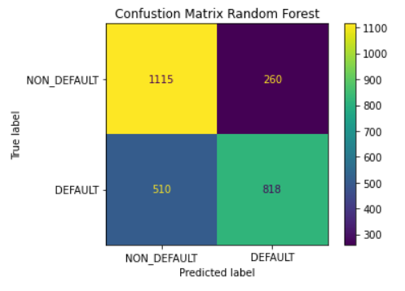
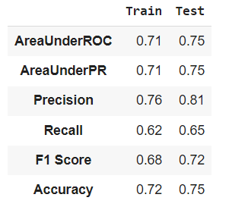
Random Forest Model
Parameter Tuning Grid Search
5 Different Parameters
480 Total Models
Results:

Slide 12
Random Forest Error Analysis
Top Feature Importance: Pay Status of July, August, and September and Credit Limit Balance
Error Trends:
Struggled to predict non-default when previous payment was already defaulted (increasing tree depth may have improved this error)
Over-reliance on amount of debt (billing amount compared to payment amount)
Predicted defaults on people with no debt

Slide 13
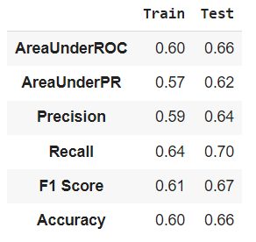
Deep Learning Model (Multilayer Perceptron)
Parameter Tuning:
block size and step side grid search (44 models)
200 max iterations and 12 hidden layer neurons
Best Parameter Model:
Block size = 64, Step size = 0.005
Final Model: 25000 iterations with 500 hidden layer neurons

Slide 14
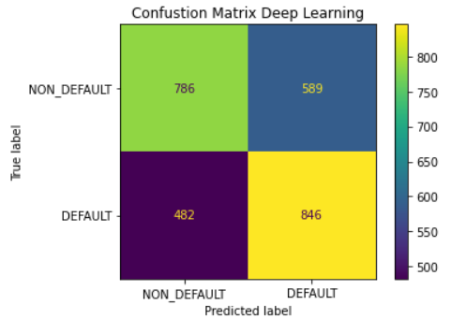
Deep Learning Error Analysis
Error Analysis
Struggled with high billing amounts (relative to payment)
Consistently predicted defaults for accounts that previously defaulted regardless of account balance

Slide 15
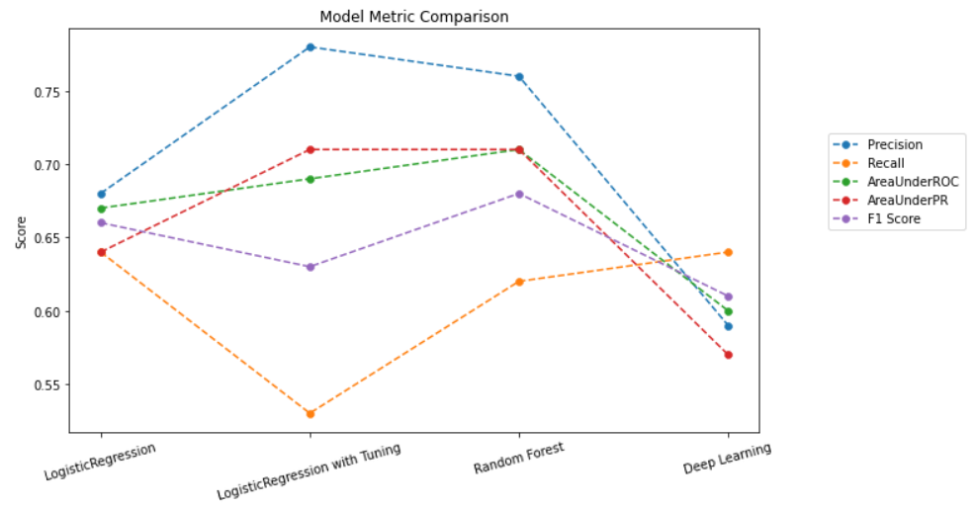
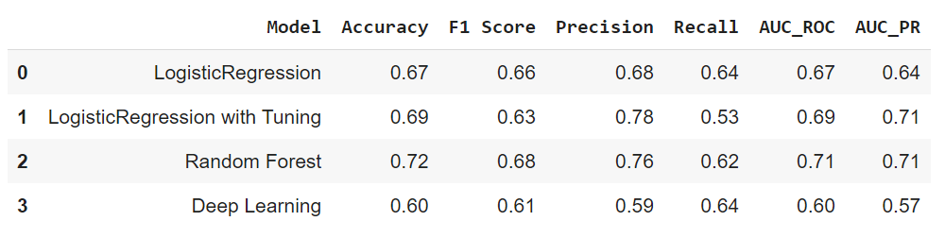
Model Comparison

Slide 16
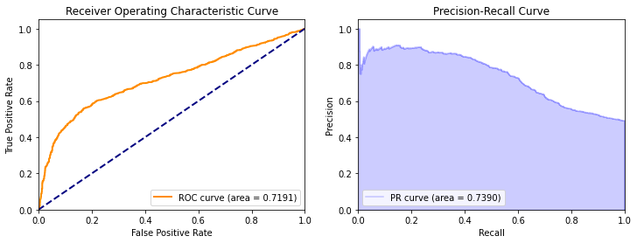
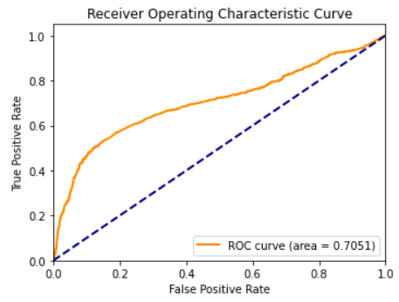
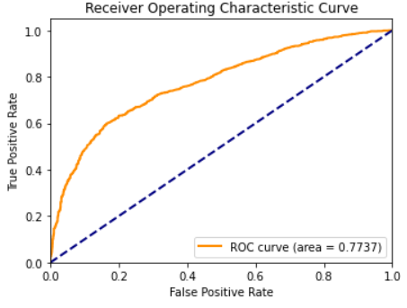
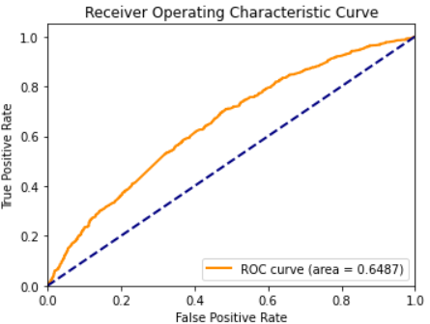
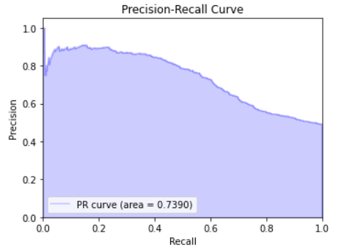
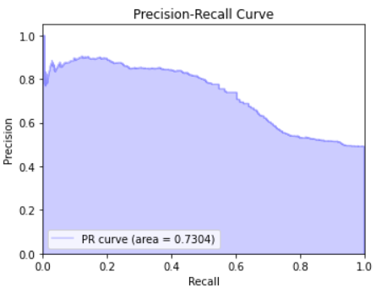
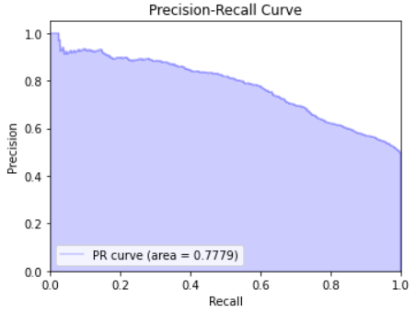
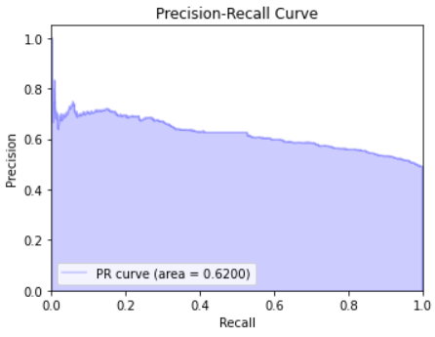
Model Comparison (cont.)
Logistic Regression
Tuned Logistic Regression
Random Forest
Deep Learning

Slide 17
Result Summary
Random Forest Modeling was best at predicting credit card default
Low payments relative to high bills consistently indicated delinquency
Default predictions were much more likely to be accurate than non-default predictions (high precision)
Regularization of Logistic Regression model helped in feature selection
Random Forest & Logistic Regression models indicate payment status of september having higher influence on default prediction

Slide 18
Unexpected Issues
Supporting Documentation for Variables
The training time of the multilayered perceptron model (initial parameters → 6 hr+ runtime)
Expired GPU increased code runtime

Slide 19
Future Explorations
Allot more time for deeper random forest models and more multilayer perceptron neurons
Subset data into customers with previous defaults and customer without previous defaults
Time series analysis

Slide 20
Task Allocation
Chaithra K C
Data Collection & Wrangling
Data Exploration
Feature Engineering
Logistic Regression (default params & regularization)
Model Comparison
Kevin Harmer
Data Wrangling
Data Exploration
Random Forest Classifier
MultiLayer Perceptron Classifier
Model Comparison

Slide 21
Questions?

Slide 22
Reference Links
https://www.fool.com/the-ascent/research/credit-card-company-earnings/
https://www.forbes.com/advisor/credit-cards/credit-card-statistics/#:~:text=A%20recent%20study%20by%20the,make%2028%25%20of%20all%20payments
https://www.lendingtree.com/credit-cards/credit-card-debt-statistics/
https://www.analyticsvidhya.com/blog/2020/07/10-techniques-to-deal-with-class-imbalance-in-machine-learning/

